Slide 1
E-Commerce Inventory, Offers & Claim Management System
Project Demo
December 3, 2022

Slide 2




Team AMAR
Akhil Talashi
Mital Bhanushali
Anandita Deb
Rutuja Ghate

Slide 3
ER Diagram

Slide 4
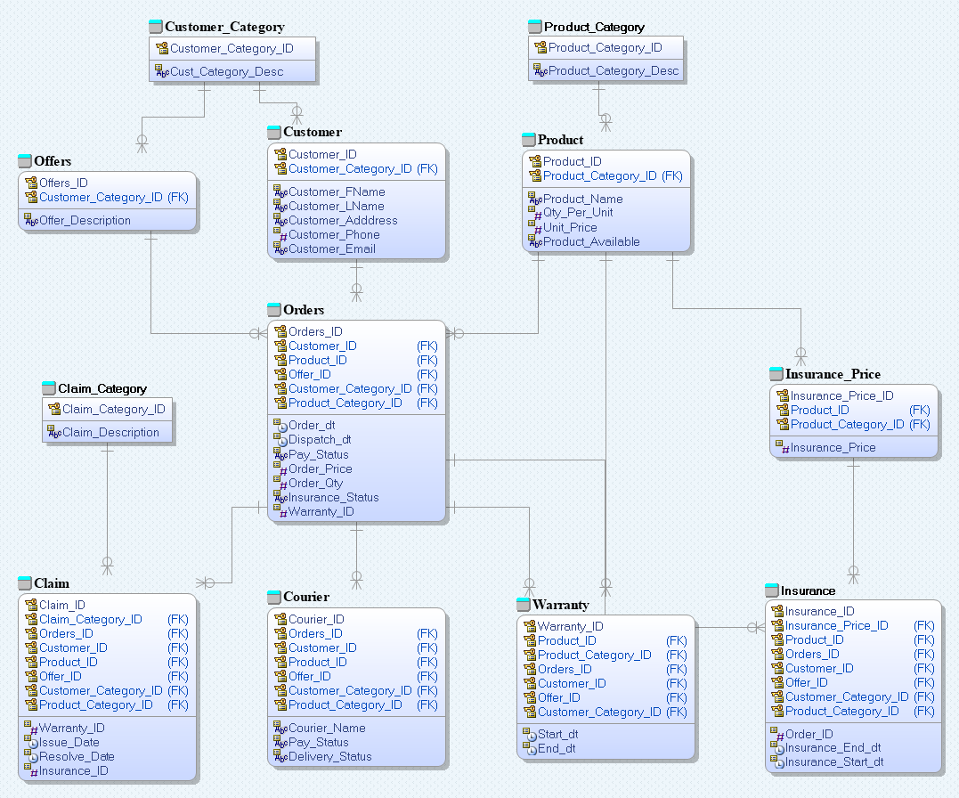
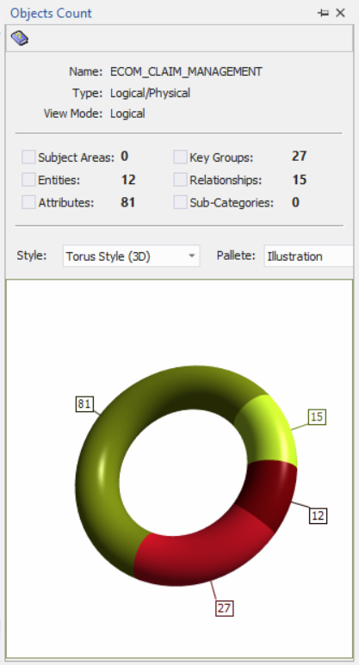
ER Diagram

Slide 5
Understanding E-Commerce System Design

Slide 6
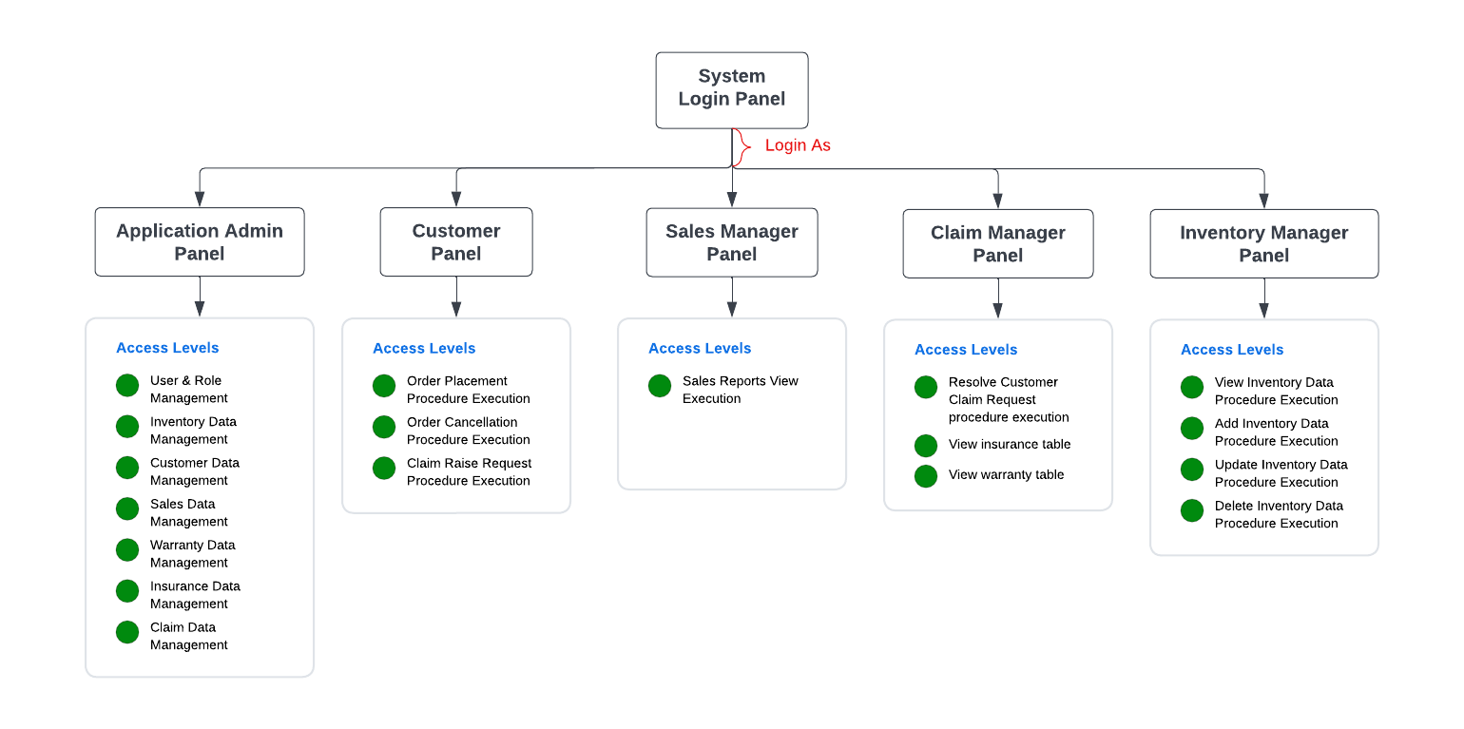
System Design

Slide 7
System Functionalities

Slide 8
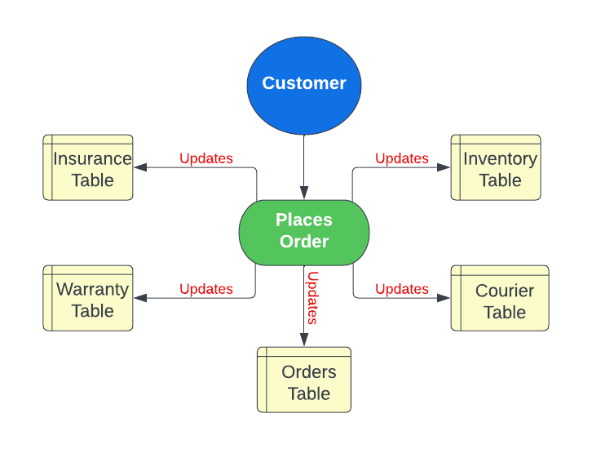

Customer Order Creation & Cancellation
Order Creation
Order Cancellation

Slide 9
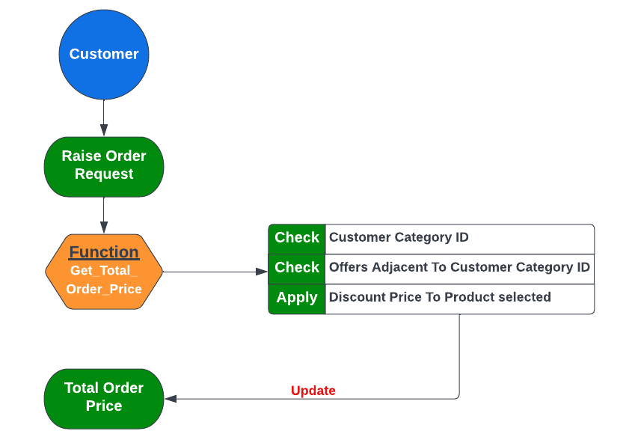
Offers
Providing Offers W.R.T Customer Type

Slide 10
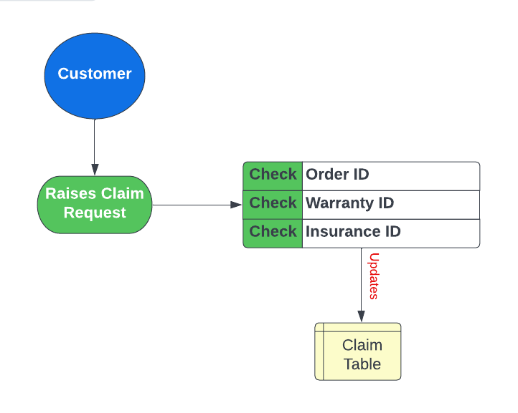
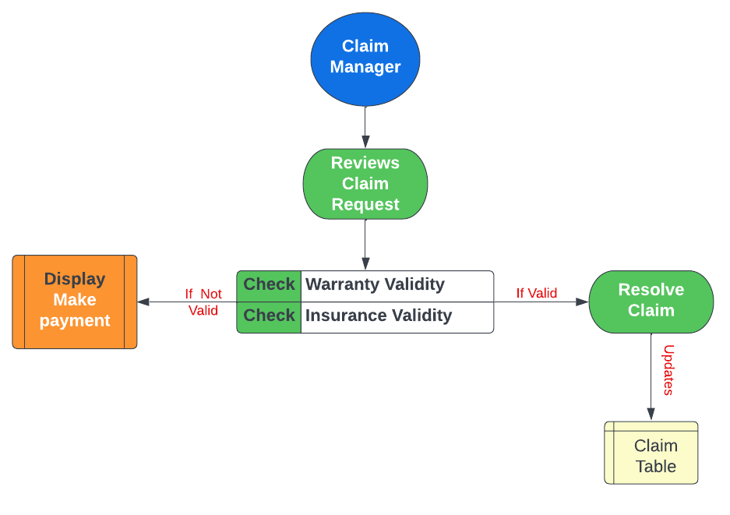
Customer Claim Raise & Resolve
Raise Claim Request
Resolve Claim Request

Slide 11
Deliverables

Slide 12
Tables

Slide 13
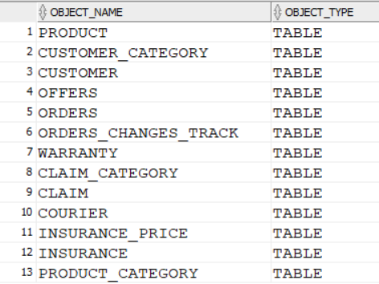
Tables

Slide 14
Views

Slide 15
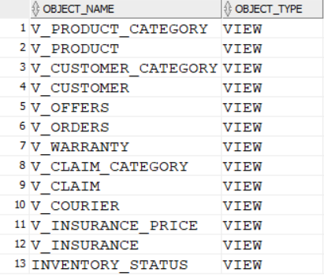
Views

Slide 16
Reports

Slide 17
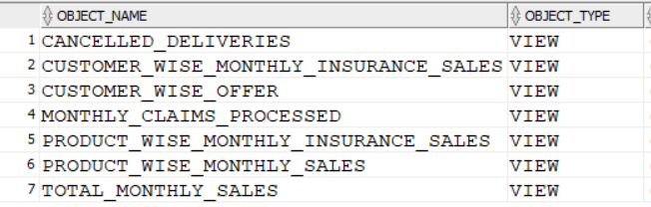
Reports

Slide 18
Indexes

Slide 19
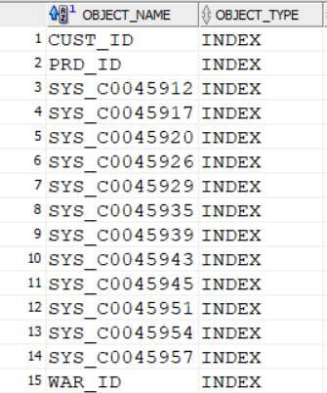
Indexes

Slide 20
Triggers

Slide 21

Triggers

Slide 22
Stored Procedures, Functions, Packages & Sequences

Slide 23
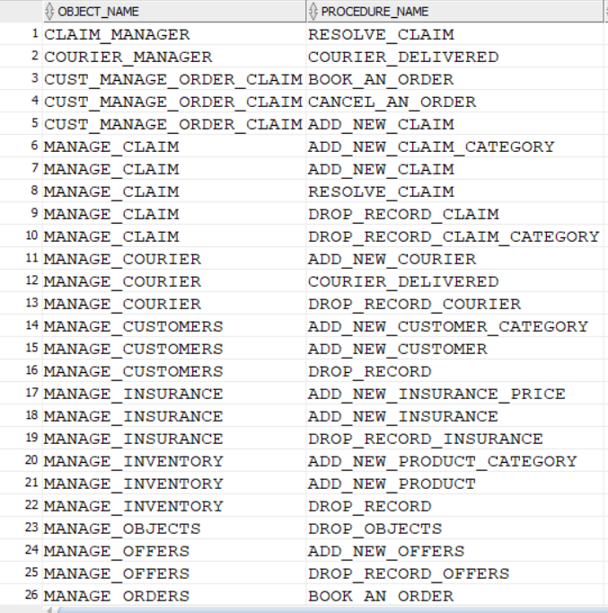
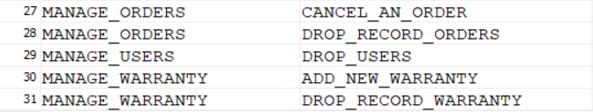
Stored Procedures

Slide 24

Functions

Slide 25
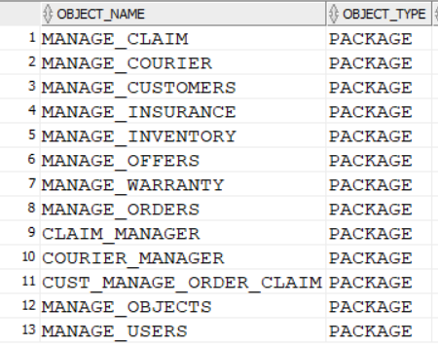
Packages

Slide 26
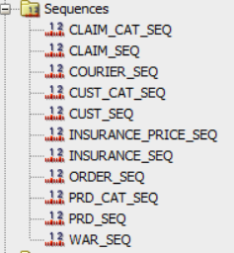
Sequences

Slide 27
Team Contribution

Slide 28
Contribution
Packages
MANAGE_USERS
CLAIM_MANAGER
MANAGE_CLAIM
MANAGE_WARRANTY
MANAGE_INSURANCE
User & Role Creation
Reports & Views creation
QA Testing
PPT
Akhil Talashi

Slide 29
Contribution
Packages
MANAGE_OFFERS
CUSTOMER_CATEGORY
MANAGE_CUSTOMER
Sequences
Indexes
Reports & Views creation
QA Testing
Rutuja Ghate

Slide 30
Contribution
Packages
MANAGE_INVENTORY
MANAGE_COURIER
COURIER_MANAGER
QA Testing
Reports & Views creation
Documentation
GIT Push Manager
Anandita Deb

Slide 31
Contribution
Packages
MANAGE_ORDERS
MANAGE_OBJECTS
CUST_MANAGE_ORDER_CLAIM
Functions
GET_TOTAL_ORDER_PRICE
Triggers
TRACK_ORDER_CHANGES
Reports & Views creation
User & Role Creation
QA Testing
Mital Bhanushali

Slide 32
Thank You!

